Slide 1
Introduction to logic and formalism
Formal specification
KARANJA Mwangi
Predicate calculus

Slide 2
2.2 The predicate calculus
In propositional calculus each atomic symbol (P, Q, e.t.c), denotes a proposition of some complexity. Its not easy to access the components of an individual assertion.
Predicate calculus provides the ability of accessing the components of an individual assertion.
  For example, instead of letting a single propositional symbol, P, denote the entire sentence "it rained on Tuesday," we can create a predicate weather that describes a relationship between a date and the weather: weather (tuesday, rain). Through inference rules we can manipulate predicate calculus expressions, accessing their individual components and inferring new sentences.
  Predicate calculus also allows expressions to contain variables:
Notes:
Inference rules: The relationship that holds between the premises and the conclusion of a logical argument, or the process of drawing a conclusion from premises that support it deductively or inductively

Slide 3
Variables let us create general assertions about classes of entities. E.g. we could state that for all values of X where X is a day of the week, the statement weather(X, rain) is true meaning it rains everyday

Slide 4
2.2.1 Syntax of Predicates and Sentences
Before we define the syntax of correct expressions in the predicate calculus we define the alphabet and grammar for creating the symbols of the language. Predicate calculus symbols can be represented as strings of letters and digits beginning with a letter.
  Blanks and non alphanumeric characters (e.g #) cannot appear within the string, although the underscore, _, may be used to improve readability.
PREDICATE CALCULUS SYMBOLS
The alphabet that makes up the symbols of the predicate calculus consists of'.
  1. The set of letters, both upper- and lowercase, of the English alphabet.
  2. The set of digits, 0, 1, ..., 9.
  3. The underscore,_.

Slide 5
Symbols in the predicate calculus begin with a letter and are followed by any sequence of these legal characters. Legitimate characters in the alphabet of predicate calculus symbols include
  aR69p_z
Examples of characters not in the alphabet include
  #%@/& ....
Legitimate predicate calculus symbols include
  George fire3 tom_andierry bill friends of
Examples of strings that are not legal symbols are
  3jack, "no blanks allowed" , ab%ed, **'71 , duck!!!

Slide 6
predicate calculus symbols
l(g,k) and likes(george, kate) are formally equivalent, the second can be of great help (for human readers) in indicating what relationship the expression represents.
descriptive name are intended solely to improve the readability of expressions.
improper symbols: include parentheses "( )", commas ",", and periods ".“ are used to construct well formed expressions and do not denote objects or relations in the world.

Slide 7
Predicate calculus symbols may represent either variables, constants, functions, or predicates.
  Constant symbols must begin with a lowercase letter. The constants true and false are reserved as truth symbols. Thus george, tree, tall, blue are examples of well formed constant symbols
  Variable symbols are used to designate general classes of objects or properties in the world. Variables are represented by symbols beginning with an uppercase letter. Thus George, Bill, Kate are legal variables, whereas geoRGE and bill are not.
  Functions denote a mapping of one or more elements in a set into a unique element of another set. Function symbols (likes) begin with a lowercase letter.
Notes:
Variables begin uppercase letters
Constant symbols begin lowercase letters
The act of replacing a function with its value is called evaluation

Slide 8
A (function or predicate) symbol of arity 0 is called a constant
Sometimes we use the superscript to indicate the arity of a symbol e.g we may write f² for a binary function symbol, or plus could be a function of arity 2. if plus(2,3) is a function expression whose value is an integer 5 , then the act of replacing a function with its value is called evaluation
We use letters f, g, h .. ..to denote function symbols and use P, Q, R to denote predicate symbols

Slide 9
Definition: SYMBOLS and TERMS
Predicate calculus symbols include:
  1. Truth symbols true and false (these are reserved symbols).
  2. Constant symbols are symbol expressions having the first character lowercase.
  3. Variable symbols are symbol expressions beginning with an uppercase character.
  4. Function symbols are symbol expressions having the first character lowercase. Functions have an attached arity indicating the number of elements of the domain mapped onto each element of the range.
  A function expression is a function symbol followed by its arguments. The argument are the elements from the domain of the function. Hence the number of argument is equal to the arity of the function. A predicate calculus term is either a constant, variable, or function expression.

Slide 10
thus a predicate calculus term may be used to denote objects and properties in a problem domain.
  cat, times(2,3), X, blue, mother(jane), kate
Symbols in predicate calculus may also represent predicates. Predicate symbols, begin with a lowercase letter.
  likes, equals, on, near, part_of

Slide 11
atomic sentence:
  the most primitive unit of the predicate calculus language, is a predicate of arity n followed by n terms enclosed in parentheses and separated by commas.
  likes(george, kate) likes(X, george)
  likes(george, susie) likes(X, X)
  likes(george, sarah, tuesday) friends(bill,richard)
  friends(bill, george) friends(father_of(david), father_of(andrew))
  helps(bill,george) helps(richard,bill)
  The predicate symbols in these expressions are likes, friends, and helps.
  Bill, george, kate are constant symbols and represent objects in the problem domain
  The arguments to a predicate are terms and may also include variables or function expressions. E.g
  friends(father_of(david), father_of(andrew))

Slide 12
Definition: PREDICATES and ATOMIC SENTENCES
Predicate symbols are symbols beginning with a lowercase letter.
Predicates have an associated non-negative integer referred to as the arity or "argument number" for the predicate. Predicates with the same name but different arities are considered distinct.
An atomic sentence is a predicate constant of arity n, followed by n terms, t₁, t₁, …t_{n}, enclosed in parentheses and separated by commas.
The truth values, true and false, are also atomic sentences.
Atomic sentences are also called atomic expressions, atoms, or propositions.

Slide 13
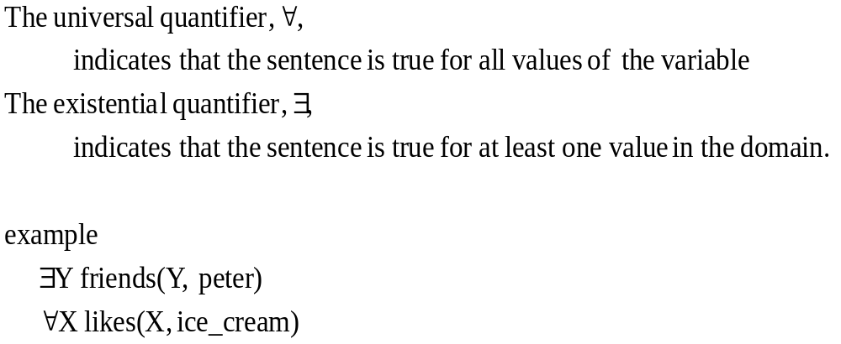
variable quantifiers
Notes:
In a set of Y, there exist some friends of peter
All elements in X like ice cream

Slide 14
Definition: PREDICATE CALCULUS SENTENCES
Every atomic sentence is a sentence
If s is a sentence, then so is its negation, ¬s.
If s1 and s2 are sentences, then so is their conjunction, s1 Λ s2
If s1 and s2 are sentences, then so is their disjunction s1 ٧ s2
If s1 and s2 are sentences, then so is their implication s1 → s2
If s1 and s2 are sentences, then so is their equivalence s1 ≡ s2
if X is a variable and s a sentence, then ∀X s is a sentence
If X is a variable and s is a sentence, then 3X s is a sentence

Slide 15
Examples of well-formed sentences
Let times and plus be function symbols of arity 2 and let equal and foo be predicate symbols with arity 2 and 3 respectively.
plus(two,three) is a function and thus not an atomic sentence
equal(plus(two,three), five) is an atomic sentence
equal(plus(2,3),seven) is an atomic sentence. I n this sentence, the standard interpretation of plus and equal is false. Well-formedness and truth values are two different issues.

Slide 16
Examples..ctd
∃X foo(X,two, plus(two, three)) ∧ equal(plus(two, three),five) is a sentence because both conjuncts are sentences

Slide 17
recursive algorithm
function verify_sentence(expression);
begin
case
expression is an atomic sentence: return SUCCESS;
expression is of the form Q X s, where Q is either V or 3, X is a variable,
and s is a sentence:
if verify_sentense(s) returns SUCCESS
then return SUCCESS
else return FAIL;
expression is of the form ￢s:.
if verify_sentence(s) returns SUCCESS
then return SUCCESS
else return FAIL;
expression is of the form s₁ op s₂, where op is a binary logical operator:
if verify_sentence(s₁) returns SUCCESS and
verify_sentense(s₂) returns SUCCESS
then return SUCCESS
else return FAIL;
otherwise: return FAIL
end
end.
Notes:
From the predicate calculus and examples presented suggests that a method for verifying that an expression is a sentence

Slide 18
Concluding predicate calculus
Example-use of predicate calculus to describe a simple world.
    mother(eve, abel)
    mother(eve, cain)
    father(adam, abel)
    father(adam, cain)
∀X∀Y(father(X, Y)) ∨ mother(X,Y)→parent(X,Y)
∀X∀Y∀Z(parent(X,Y)) ∧ parent(X,Z)→sibling(Y,Z)
Mother and father are used to define the parent-child relationships.
Implications give general definitions of other relationships, i.e. parent and sibling
Implications can be used to infer facts such as sibling(cain , abel)

Slide 19
Care must be taken in defining an inference algorithm and ensure that such algorithms draw correct conclusions from a set of predicate calculus assertions

Slide 20
Semantics for the predicate calculus
Predicate calculus semantics provide a formal basis for determining the truth value of the well formed expressions. The truth of the expressions depends on the mapping of constants, varables, predicates, and functions into objects and relations in the domain of discourse. The truth of relationships in the domain determines the truth of the corresponding expressions. e.g. george and his friends may be expressed as follows.
friends(george, susie)
friends(george, kate)
If it is true that george is a friend of susie and george is a friend of kate then each expression would have a truth value (assignment) T.

Slide 21
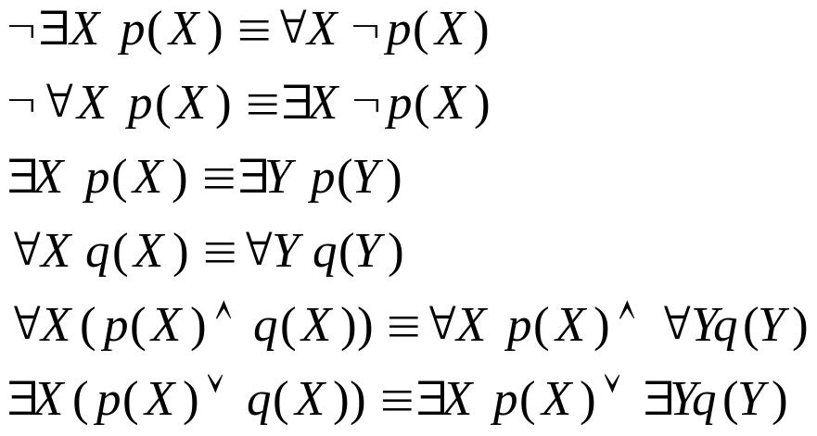
Relationships btwn negation and the universal and existential quantifiers
For predicates p and q and variables X and Y
In the above, universally and existentially quantified variables may refer only to objects (constants) in the domain of discourse. Predicate and function names may not be replaced by quantified variables. This language is called the first-order predicate calculus

Slide 22
first-order predicate calculus(1)
First-order predicate calculus allows variables to refer to objects in the domain of discourse and not to predicates or functions
E.g ∀(Likes)Likes(george, kate) is not a well formed expression in the first- order predicate calculus

Slide 23
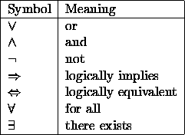
first-order predicate calculus(2)
The predicate calculus includes a wider range of entities. It permits the description of relations and the use of variables. It also requires an understanding of quantification.
The language of predicate calculus requires:
Variables
Constants
  ---these include the logical constants
  The last two logical constants are additions to the logical connectives of propositional calculus ---they are known as quantifiers
The non-logical constants include both the `names' of entities that are related and the `names' of the relations. For example, the constant dog might be a relation and the constant fido an entity.
Dog(fido)

Slide 24
first-order predicate calculus(3)
jim is tall
might be represented either as
  tall(jim)
  or
  jim(tall)
loves(jane,jim).
then jane and jim refer to specific objects. Both jane and jim are constants
NOTE: Because Prolog is modeled on a subset of first order predicate logic, all predicate names must be constants ---but not numbers
NO PREDICATE MAY BE A VARIABLE
we cannot have X(jane,jim) as representing the fact that jane and jim are related in some unknown way
Notes:
It is, perhaps, preferable to see tallness as being a property which is possessed by jim

Slide 25
exercise
Represent the following sentences in prolog form
bill likes ice-cream
bill is tall
jane hits jimmy with a cricket bat
john travels to london by train
bill takes jane some edam cheese
Note: (1)constants do not start with upper case letters
(2) there are several ways of representing the above statements

Slide 26
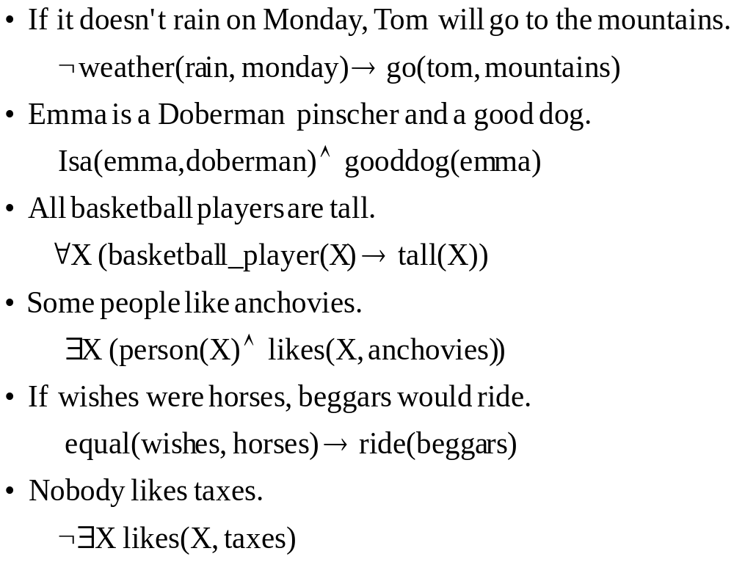
Examples of English sentences represented in predicate calculus
Notes:
Representation of statements in Prolog

Slide 27
exercise
Represent the following sentences in predicate calculus
All animals eat custard
Everyone loves bebecool’s music
Jim likes fred’s possessions
If someone needs a bike then they may borrow janes

Slide 28
Examples of predicate logic to practice on!!!!!!!
All fruit is tasty if it is not cooked. This apple is not cooked. Therefore, it is tasty.
All fruit is tasty if it is not cooked. This apple is cooked. Therefore, it is not tasty.
Some fruit is tasty if it is not cooked. This apple is cooked. Therefore, it is not tasty.
Some fruit is tasty if it is not cooked. This apple is not cooked. Therefore, it is tasty.
All that glistens is not gold. This pot does not glisten. Therefore, it is gold.
No lecturer who spends her time writing books on logic or who devotes herself to her students will come to the notice of the establishment. No one who does not come to the notice of the establishment will secure preferment. Therefore, no lecturer who spends her time writing books on logic will secure preferment.

Slide 29
Examples of predicate logic
Dilly loves all and only those who love Milly. Milly loves all and only those who do not love Dilly. Dilly loves herself. Therefore, Milly loves herself.
All those who honor both their parents are blessed. If anyone dislikes any of his siblings he does not honor his parents. Jack likes his sister, Jill. Therefore Jack is blessed.
All lecturers are determined. Anyone who is determined and intelligent will give satisfactory service. Clare is an intelligent lecturer. Therefore Clare will give satisfactory service.
All men are mortal. Socrates is mortal. Therefore Socrates is a man.
All men are mortal. Socrates is a man. Therefore Socrates is mortal.
Every student likes logic. If a person likes logic and studies hard, she will pass all her exams. Joann is a lover of logic who studies hard. Therefore, Joann will pass her tomorrow's exam.
Some musician are writers. Some mathematicians are not writers. Therefore, some mathematicians are not musicians.

Slide 30
Satisfy, model, valid, inconsistent (cont’d)
A set of expressions is satisfiable iff there is an interpretation and variable assignment that satisfy every element.
If a set of expressions is not satisfiable, it is said to be inconsistent.
If X has a value T for all possible interpretations, X is said to be valid.
The expression ∃X(p(X)∧¬p(X)) is incosistent because it cant be satisfied under any interpretation. On the other hand ∀X(p(X)∨¬p(X)) is valid
The truth table method can be used to test validity for an expression not containing variables. However there are proof procedures that can produce any expression that logically follows from a set of expressions. These are called complete proof procedures
Notes:
Because it is not always possible to decide the validity of expressions containing variables, the process may not terminate hence the full predicate calculus “undecidable” however there are…………

